Slide 1




Artificial Intelligence Training
Multi-Tiered AI & Data Management Training Program for Northern Command

Slide 2

Exploratory Data Analysis (EDA) Summary statistics basics Descriptive stats in Pandas Correlation matrix Visualizing correlations Outlier detection (z-score) Outlier detection (IQR method) Pattern identification Defense dataset insights
Introduction to Machine Learning Concepts What is ML & why it matters Supervised learning Unsupervised learning Reinforcement learning ML pipeline Lifecycle case study
Defense related Case Studies (Demos)
01

Slide 3
Exploratory Data Analysis
1. Summary Statistics
Purpose: To describe and summarize data.
Formulas:
Mean (μ) = (Σx) / n
Median = Middle value when data is sorted
Variance (σ²) = Σ(x - μ)² / n
Standard Deviation (σ) = √Variance
Example (Performance Scores = [75, 88, 82, 91, 85]):
Mean = (75 + 88 + 82 + 91 + 85) / 5 = 84.2
Median = 85
Variance ≈ 29.3
Std Dev = √29.3 ≈ 5.4
02

Slide 4
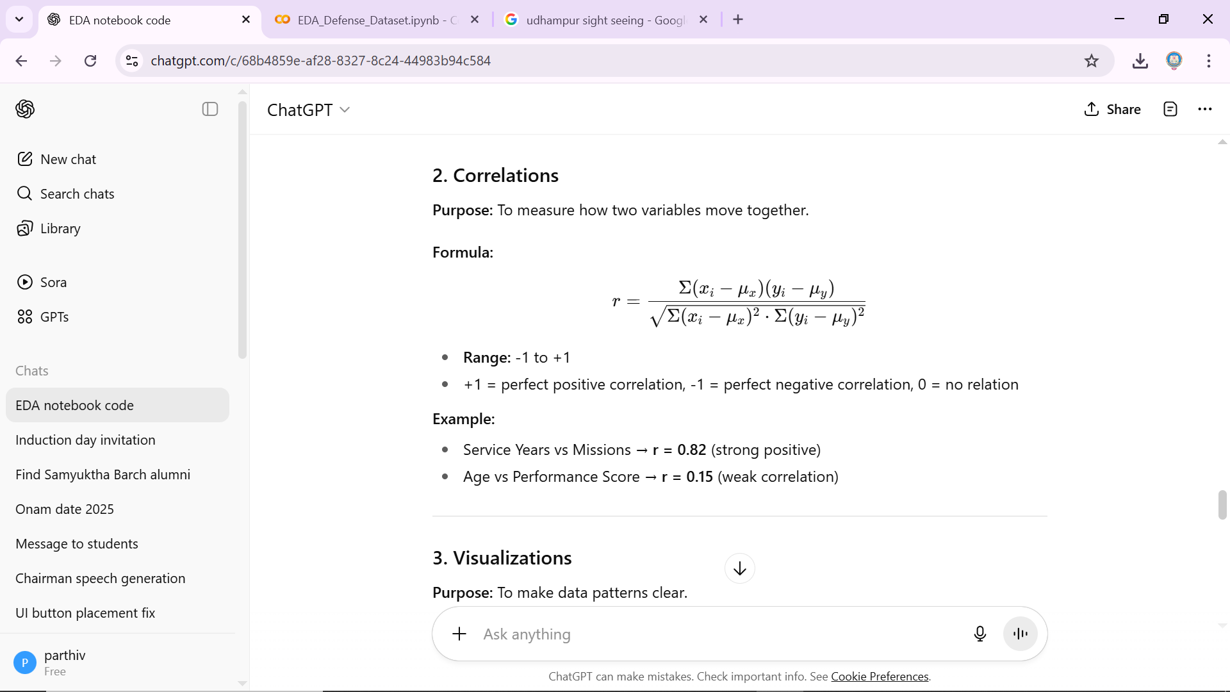
Exploratory Data Analysis
03

Slide 5
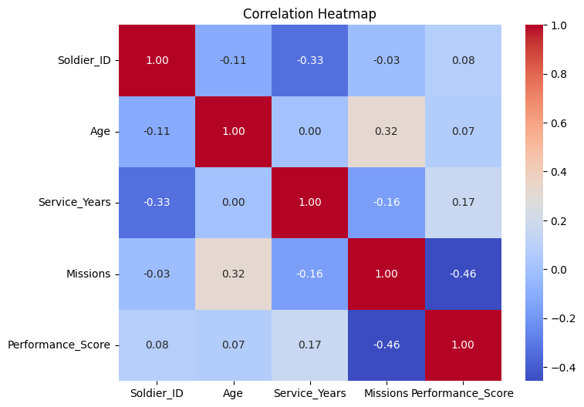
Exploratory Data Analysis
3. Visualizations
Purpose: To make data patterns clear.
Histogram: Shows distribution
Scatter Plot: Shows relation between two variables
Heatmap: Shows correlation matrix
Example:
Scatter plot of Service Years vs Performance Score shows higher scores with more experience.
04

Slide 6
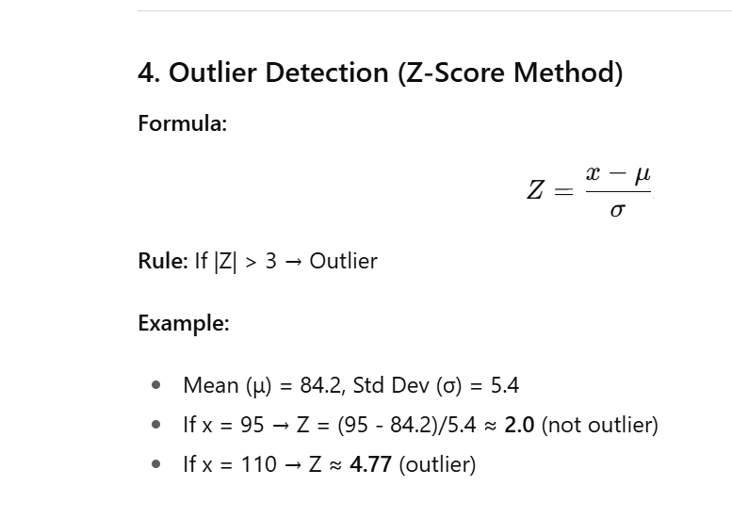
Exploratory Data Analysis
05

Slide 7
Exploratory Data Analysis
5. Outlier Detection (IQR Method)
Formula:
IQR = Q3 - Q1
Lower bound = Q1 - 1.5×IQR
Upper bound = Q3 + 1.5×IQR
Example (Performance Scores):
Q1 = 78, Q3 = 89 → IQR = 11
Lower bound = 78 - (1.5×11) = 61.5
Upper bound = 89 + (1.5×11) = 105.5
Any score outside [61.5, 105.5] = outlier
06

Slide 8
Exploratory Data Analysis
6. Pattern Finding
Purpose: To find hidden trends.
Example:
Soldiers with >15 years of service generally have Performance Scores >85
Missions positively impact performance (more missions → higher score trend).
07

Slide 9
Exploratory Data Analysis
7. Dataset Insights
Example (Defense Dataset):
Average soldier age = 32 years
Average missions completed = 8
Strongest correlation = Service Years vs Missions
Outliers highlight soldiers with exceptionally high or low performance.
08

Slide 10
Exploratory Data Analysis
Hands-on : Exploratory Data Analysis: https://colab.research.google.com/drive/116PUF-DmTNG3FltQ21NA1ykBbxiNNuyA?usp=sharing.
09

Slide 11
Exploratory Data Analysis
Hands-on : Exploratory Data Analysis: Simple Defense data EDA: https://colab.research.google.com/drive/1u2hO6i4j6noNcqQvazjZge7nX22iS0O-?usp=sharing Defense Logistics Dataset: https://colab.research.google.com/drive/1qKV5_kvNM7oeIuVJzsOW9gRIuZPoc7wW?usp=sharing
10

Slide 12
Introduction to Machine Learning

Slide 13
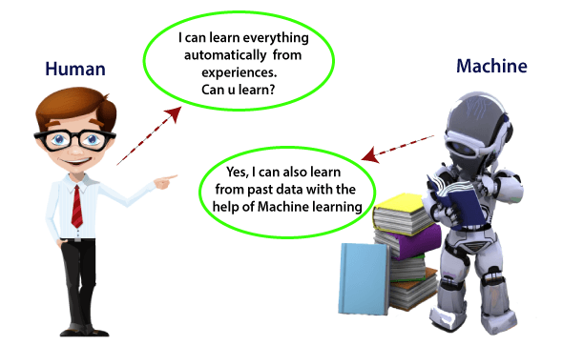
What is Machine Learning?
Branch of AI that learns from data.
No need for explicit programming of rules.
Learns patterns and makes predictions.
Improves with more data & iterations.
Widely used across industries.
Example: Spam filtering in Gmail.
Analogy: Teaching a child with examples.
Key: Machines adapt from experience.
11

Slide 14
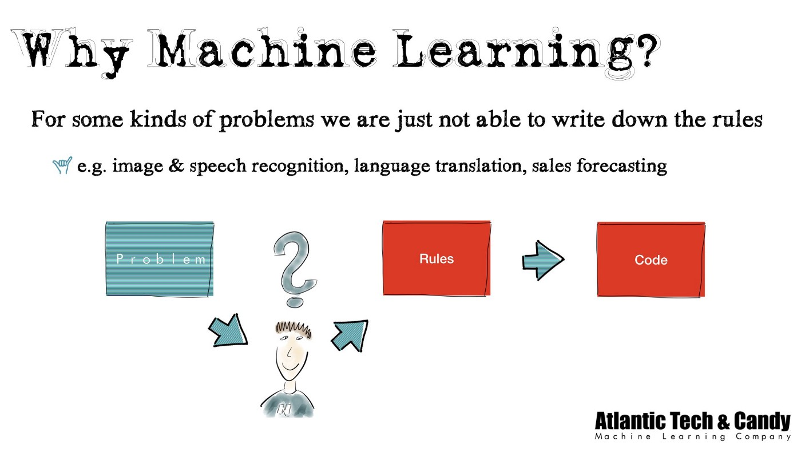
What is Machine Learning?
Explosion of data (Big Data era).
Human analysis → limited, slow.
ML → automatic, scalable, adaptive.
Provides predictions & recommendations.
Helps detect anomalies & fraud.
Reduces manual rule writing.
Constantly improves with feedback.
Backbone of modern AI applications.
12

Slide 15
How Machine Learning works
Input data → Feature extraction → Model training → Prediction.
Labeled/unlabeled data used.
Algorithms learn rules automatically.
Output evaluated against truth.
Feedback loop improves accuracy.
Example: Email text → spam filter.
Models generalize patterns.
Aim: Minimize prediction error.
13

Slide 16
Data is the Fuel
Quality data critical for ML.
Structured data: Tables, numbers.
Unstructured data: Images, audio.
Sources: Sensors, logs, social media.
Garbage in → Garbage out.
Preprocessing ensures clean inputs.
Balanced datasets avoid bias.
Big Data enables Deep Learning.
14

Slide 17
Features & Labels
Features = Input variables.
Labels = Output variable (target).
Example: Loan prediction → Features: Age, salary, credit score.
Label: Approved (Yes/No).
Good features → better accuracy.
Feature engineering = improving variables.
Labels may be continuous or categorical.
Features can be raw or derived.
15

Slide 18
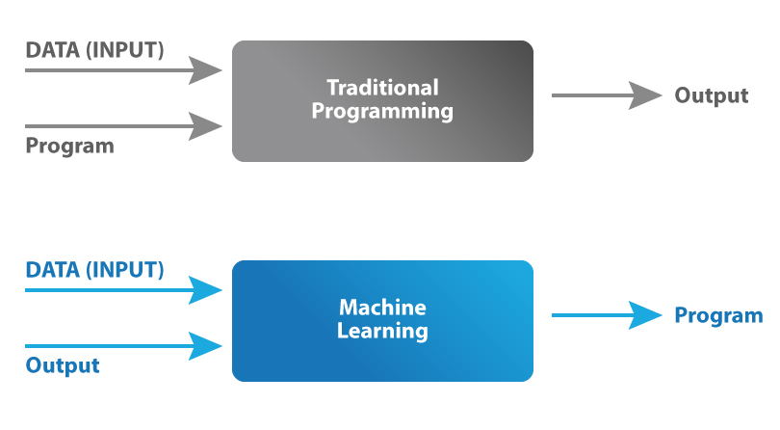
ML vs Traditional Programming
Traditional: Data + Rules → Output.
ML: Data + Output → Rules (Model).
ML automates rule discovery.
Adapts with new data.
Rule-based = brittle.
ML = flexible.
Example: Spam rules vs ML spam filter.
Advantage: Scalability & adaptability.
16

Slide 19
Types of Machine Learning
Supervised: Labeled data.
Unsupervised: Unlabeled data.
Reinforcement: Rewards & penalties.
Covers most ML tasks.
Supervised = prediction tasks.
Unsupervised = pattern discovery.
RL = decision making tasks.
Visual diagram recommended.
17

Slide 20
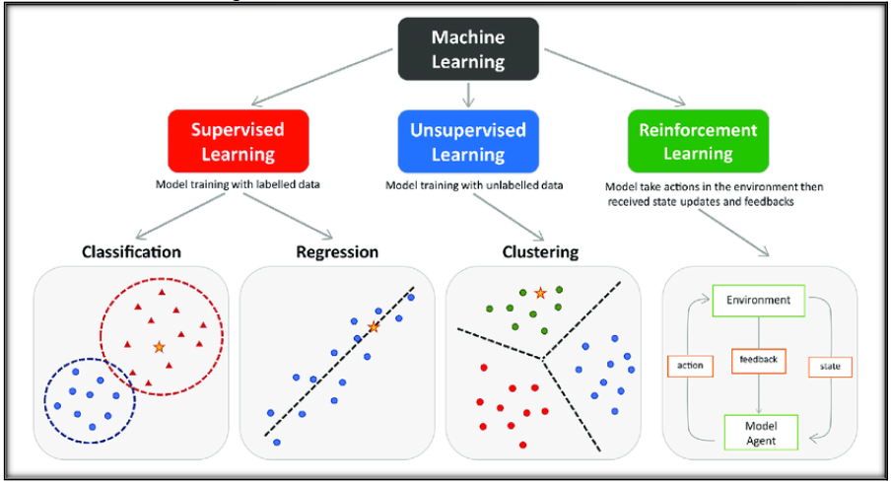
Types of Machine Learning
18

Slide 21
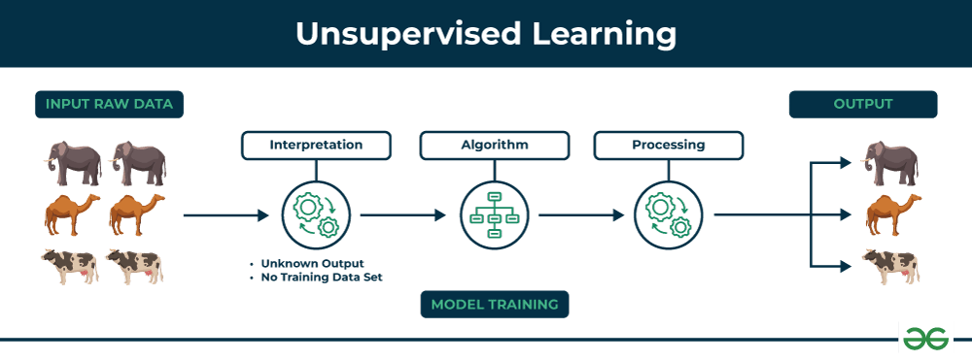
Unsupervised Learning
Data has no labels.
Finds hidden structures.
Techniques: Clustering, Dimensionality reduction.
Example: Customer segmentation.
K-means clustering popular method.
PCA reduces dimensions.
Helps explore unknown data.
Used in anomaly detection.
19

Slide 22
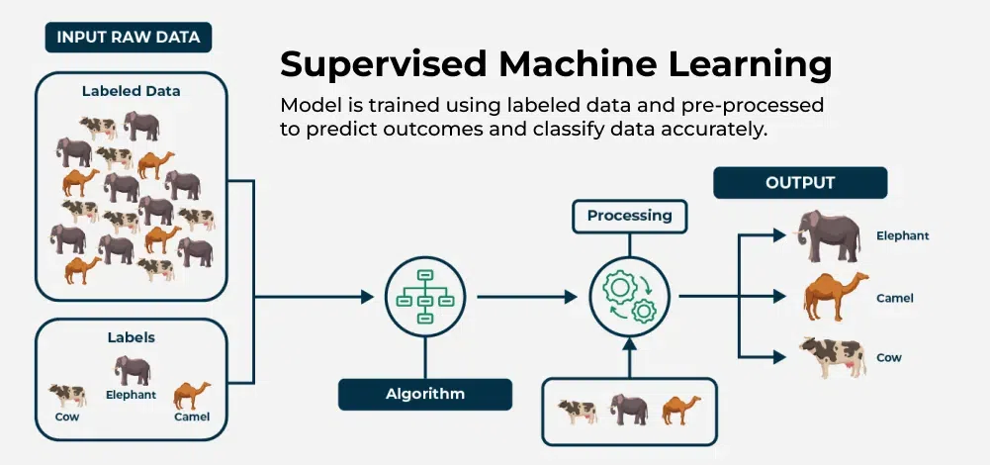
Supervised Learning
Learns from labeled data.
Input → Output mapping.
Example: Salary prediction.
Subtypes: Regression, Classification.
Needs large datasets.
High accuracy if labels are correct.
Example: Spam detection.
Limitation: Requires labels.
20

Slide 23
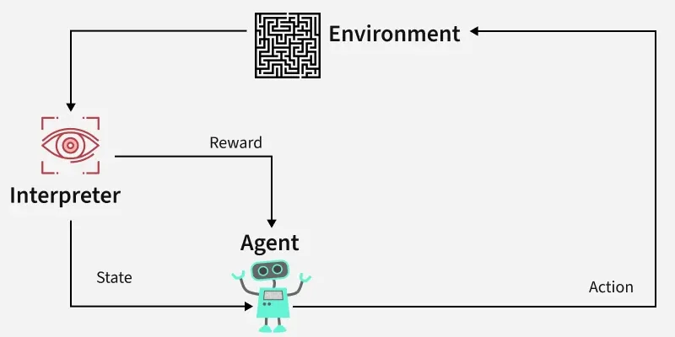
Reinforcement Learning Basics
Agent interacts with environment.
Chooses actions → gets reward/penalty.
Learns best strategies.
Goal: Maximize cumulative reward.
Example: Self-driving car.
Uses trial-and-error.
RL algorithms: Q-learning, DQN.
Inspired by human learning.
21

Slide 24
Unsupervised Learning

Slide 25
Why is it important?
They find patterns which are previously unknown.
Patterns help you to find features which can be useful for categorization.
They can detect anomalies and defects in the data.
They work on unlabeled data which makes our work easier.
22

Slide 26
Need for Unsupervised Learning
Annotating large datasets is very costly and time consuming. Example: Speech Recognition, Medical Image Analysis, etc.
There may be cases where we don’t know how many/what classes is the data divided into. Example: Data Mining, Sentimental Analysis.
We may want to use clustering to gain some insight into the structure of the data before designing a classifier
23

Slide 27
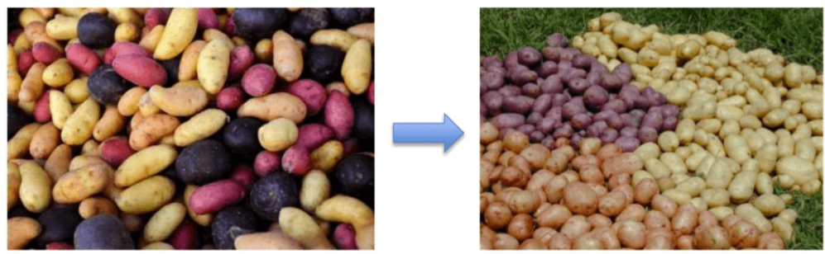
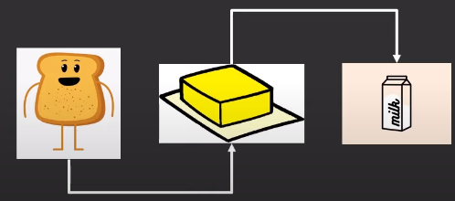
Types of Unsupervised Learning
Clustering
Clustering is the task of dividing the population or data points into a number of groups such that data points in the same groups are more similar to other data points and dissimilar to the data points in the other groups.
Association
Association rules allow us to establish associations amongst data objects inside large databases. This unsupervised technique includes discovering important relationships between variables in large databases.
24

Slide 28
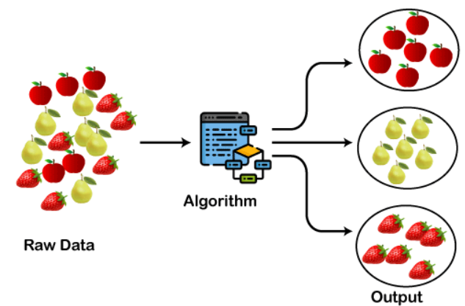
Clustering in Machine Learning
Working of the clustering algorithm
25

Slide 29
Types of Clustering Methods
Main clustering methods used in Machine learning:
Partitioning Clustering
Density-Based Clustering
Distribution Model-Based Clustering
Hierarchical Clustering
26

Slide 30
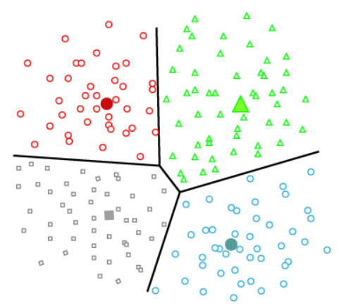
Types of Clustering Methods
1. Partitioning Clustering
It is a type of clustering that divides the data into non-hierarchical groups.
It is also known as the centroid-based method. The most common example of partitioning clustering is the K-Means Clustering algorithm.
27

Slide 31
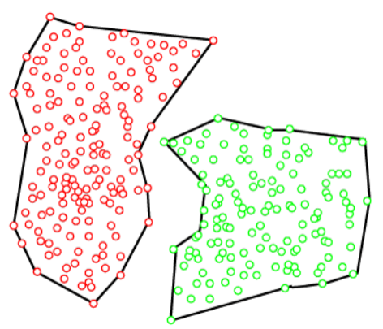
Types of Clustering Methods (CONTD.,)
2. Density-Based Clustering
The density-based clustering method connects the highly-dense areas into clusters, and the arbitrarily shaped distributions are formed as long as the dense region can be connected.
This algorithm does it by identifying different clusters in the dataset and connects the areas of high densities into clusters. The dense areas in data space are divided from each other by sparser areas.
28

Slide 32
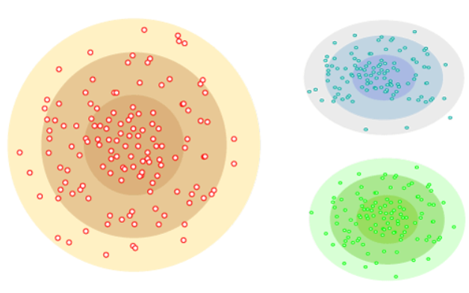
Types of Clustering Methods (CONTD.,)
Distribution Model-Based Clustering
In the distribution model-based clustering method, the data is divided based on the probability of how a dataset belongs to a particular distribution.
The grouping is done by assuming some distributions commonly Gaussian Distribution
29

Slide 33
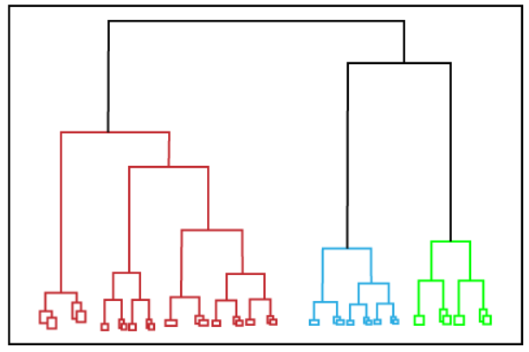
Types of Clustering Methods (CONTD.,)
Hierarchical Clustering
Hierarchical clustering can be used as an alternative for the partitioned clustering as there is no requirement of pre-specifying the number of clusters to be created.
In this technique, the dataset is divided into clusters to create a tree-like structure, which is also called a dendrogram.
The observations or any number of clusters can be selected by cutting the tree at the correct level. The most common example of this method is the Agglomerative Hierarchical algorithm.
30

Slide 34
Clustering Algorithms
K-Means algorithm:
The k-means algorithm is one of the most popular clustering algorithms.
It classifies the dataset by dividing the samples into different clusters of equal variances.
The number of clusters must be specified in this algorithm.
It is fast with fewer computations required, with the linear complexity of O(n).
31

Slide 35
K-Means Algorithm
It will group the unlabeled dataset into different clusters.
Here K defines the number of predefined clusters that need to be created in the process, as if K=2, there will be two clusters, and for K=3, there will be three clusters, and so on.
It allows us to cluster the data into different groups and a convenient way to discover the categories of groups in the unlabeled dataset on its own without the need for any training.
It is a centroid-based algorithm, where each cluster is associated with a centroid. The main aim of this algorithm is to minimize the sum of distances between the data point and their corresponding clusters.
The algorithm takes the unlabeled dataset as input, divides the dataset into k-number of clusters, and repeats the process until it does not find the best clusters. The value of k should be predetermined in this algorithm.
32

Slide 36
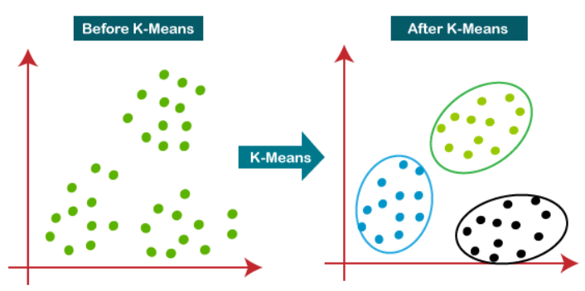
K-Means Algorithm (CONTD.,)
The k-means clustering algorithm mainly performs two tasks:
Determines the best value for K center points or centroids by an iterative process.
Assigns each data point to its closest k-center. Those data points which are near to the particular k-center, create a cluster.
working of the K-means Clustering Algorithm:
33

Slide 37
The working of the K-Means algorithm is explained in the below steps:
Step-1: Select the number K to decide the number of clusters.
Step-2: Select random K points or centroids. (It can be other from the input dataset).
Step-3: Assign each data point to their closest centroid, which will form the predefined K clusters.
Step-4: Calculate the variance and place a new centroid of each cluster.
Step-5: Repeat the third steps, which means reassign each datapoint to the new closest centroid of each cluster.
Step-6: If any reassignment occurs, then go to step-4 else go to FINISH.
Step-7: The model is ready.
34

Slide 38
Solved Example
let us solve a numerical problem on k means clustering. The problem is as follows. You are given 15 points in the Cartesian coordinate system as follows.
Point | Coordinates
A1 | (2,10)
A2 | (2,6)
A3 | (11,11)
A4 | (6,9)
A5 | (6,4)
A6 | (1,2)
A7 | (5,10)
A8 | (4,9)
A9 | (10,12)
A10 | (7,5)
A11 | (9,11)
A12 | (4,6)
A13 | (3,10)
A14 | (3,8)
A15 | (6,11)
First, we will randomly choose 3 centroids from the given data. Let us consider A2 (2,6), A7 (5,10), and A15 (6,11) as the centroids of the initial clusters. Hence, we will consider that
Centroid 1=(2,6) is associated with cluster 1.
Centroid 2=(5,10) is associated with cluster 2.
Centroid 3=(6,11) is associated with cluster 3.
Now we will find the Euclidean distance between each point and the centroids.
Based on the minimum distance of each point from the centroids, we will assign the points to a cluster.
Tabulate the distance of the given points from the clusters in the following table
35
Table 1 : Input Dataset

Slide 39
1st Iteration Results
Point | Distance from Centroid 1 (2,6) | Distance from Centroid 2 (5,10) | Distance from Centroid 3 (6,11) | Assigned Cluster
A1 (2,10) | 4 | 3 | 4.123106 | Cluster 2
A2 (2,6) | 0 | 5 | 6.403124 | Cluster 1
A3 (11,11) | 10.29563 | 6.082763 | 5 | Cluster 3
A4 (6,9) | 5 | 1.414214 | 2 | Cluster 2
A5 (6,4) | 4.472136 | 6.082763 | 7 | Cluster 1
A6 (1,2) | 4.123106 | 8.944272 | 10.29563 | Cluster 1
A7 (5,10) | 5 | 0 | 1.414214 | Cluster 2
A8 (4,9) | 3.605551 | 1.414214 | 2.828427 | Cluster 2
A9 (10,12) | 10 | 5.385165 | 4.123106 | Cluster 3
A10 (7,5) | 5.09902 | 5.385165 | 6.082763 | Cluster 1
A11 (9,11) | 8.602325 | 4.123106 | 3 | Cluster 3
A12 (4,6) | 2 | 4.123106 | 5.385165 | Cluster 1
A13 (3,10) | 4.123106 | 2 | 3.162278 | Cluster 2
A14 (3,8) | 2.236068 | 2.828427 | 4.242641 | Cluster 1
A15 (6,11) | 6.403124 | 1.414214 | 0 | Cluster 3
At this point, we have completed the first iteration of the k-means clustering algorithm and assigned each point into a cluster.
From the table , We can observe that the point that is closest to the centroid of a given cluster is assigned to the cluster.
Now, we will calculate the new centroid for each cluster.
In cluster 1, we have 6 points i.e. A2 (2,6), A5 (6,4), A6 (1,2), A10 (7,5), A12 (4,6), A14 (3,8).
To calculate the new centroid for cluster 1, we will find the mean of the x and y coordinates of each point in the cluster. Hence, the new centroid for cluster 1 is (3.833, 5.167).
In cluster 2, we have 5 points i.e. A1 (2,10), A4 (6,9), A7 (5,10) , A8 (4,9), and A13 (3,10). Hence, the new centroid for cluster 2 is (4, 9.6)
In cluster 3, we have 4 points i.e. A3 (11,11), A9 (10,12), A11 (9,11), and A15 (6,11). Hence, the new centroid for cluster 3 is (9, 11.25).
36
Table:2 Results from 1st iteration of K means clustering

Slide 40
2nd Iteration Results
Now that we have calculated new centroids for each cluster, we will calculate the distance of each data point from the new centroids. Then, we will assign the points to clusters based on their distance from the centroids. The results for this process have been given in the table.
Point | Distance from Centroid 1 (3.833, 5.167) | Distance from centroid 2 (4, 9.6) | Distance from centroid 3 (9, 11.25) | Assigned Cluster
A1 (2,10) | 5.169 | 2.040 | 7.111 | Cluster 2
A2 (2,6) | 2.013 | 4.118 | 8.750 | Cluster 1
A3 (11,11) | 9.241 | 7.139 | 2.016 | Cluster 3
A4 (6,9) | 4.403 | 2.088 | 3.750 | Cluster 2
A5 (6,4) | 2.461 | 5.946 | 7.846 | Cluster 1
A6 (1,2) | 4.249 | 8.171 | 12.230 | Cluster 1
A7 (5,10) | 4.972 | 1.077 | 4.191 | Cluster 2
A8 (4,9) | 3.837 | 0.600 | 5.483 | Cluster 2
A9 (10,12) | 9.204 | 6.462 | 1.250 | Cluster 3
A10 (7,5) | 3.171 | 5.492 | 6.562 | Cluster 1
A11 (9,11) | 7.792 | 5.192 | 0.250 | Cluster 3
A12 (4,6) | 0.850 | 3.600 | 7.250 | Cluster 1
A13 (3,10) | 4.904 | 1.077 | 6.129 | Cluster 2
A14 (3,8) | 2.953 | 1.887 | 6.824 | Cluster 2
A15 (6,11) | 6.223 | 2.441 | 3.010 | Cluster 2
Now, we have completed the second iteration of the k-means clustering algorithm and assigned each point into an updated cluster. from the table, you can observe that the point closest to the new centroid of a given cluster is assigned to the cluster.
Now, we will calculate the new centroid for each cluster for the third iteration.
In cluster 1, we have 5 points i.e. A2 (2,6), A5 (6,4), A6 (1,2), A10 (7,5), and A12 (4,6). To calculate the new centroid for cluster 1, we will find the mean of the x and y coordinates of each point in the cluster. Hence, the new centroid for cluster 1 is (4, 4.6).
In cluster 2, we have 7 points i.e. A1 (2,10), A4 (6,9), A7 (5,10) , A8 (4,9), A13 (3,10), A14 (3,8), and A15 (6,11). Hence, the new centroid for cluster 2 is (4.143, 9.571)
In cluster 3, we have 3 points i.e. A3 (11,11), A9 (10,12), and A11 (9,11). Hence, the new centroid for cluster 3 is
(10, 11.333).
37
Table:3 Results from 2nd iteration of K means clustering

Slide 41
3rd Iteration Results
Point | Distance from Centroid 1 (4, 4.6) | Distance from centroid 2 (4.143, 9.571) | Distance from centroid 3 (10, 11.333) | Assigned Cluster
A1 (2,10) | 5.758 | 2.186 | 8.110 | Cluster 2
A2 (2,6) | 2.441 | 4.165 | 9.615 | Cluster 1
A3 (11,11) | 9.485 | 7.004 | 1.054 | Cluster 3
A4 (6,9) | 4.833 | 1.943 | 4.631 | Cluster 2
A5 (6,4) | 2.088 | 5.872 | 8.353 | Cluster 1
A6 (1,2) | 3.970 | 8.197 | 12.966 | Cluster 1
A7 (5,10) | 5.492 | 0.958 | 5.175 | Cluster 2
A8 (4,9) | 4.400 | 0.589 | 6.438 | Cluster 2
A9 (10,12) | 9.527 | 6.341 | 0.667 | Cluster 3
A10 (7,5) | 3.027 | 5.390 | 7.008 | Cluster 1
A11 (9,11) | 8.122 | 5.063 | 1.054 | Cluster 3
A12 (4,6) | 1.400 | 3.574 | 8.028 | Cluster 1
A13 (3,10) | 5.492 | 1.221 | 7.126 | Cluster 2
A14 (3,8) | 3.544 | 1.943 | 7.753 | Cluster 2
A15 (6,11) | 6.705 | 2.343 | 4.014 | Cluster 2
Now, we will calculate the new centroid for each cluster for the third iteration.
In cluster 1, we have 5 points i.e. A2 (2,6), A5 (6,4), A6 (1,2), A10 (7,5), and A12 (4,6). Hence, the new centroid for cluster 1 is (4, 4.6).
In cluster 2, we have 7 points i.e. A1 (2,10), A4 (6,9), A7 (5,10) , A8 (4,9), A13 (3,10), A14 (3,8), and A15 (6,11). Hence, the new centroid for cluster 2 is (4.143, 9.571)
In cluster 3, we have 3 points i.e. A3 (11,11), A9 (10,12), and A11 (9,11). Hence, the new centroid for cluster 3 is (10, 11.333).
Here, we can observe that no point has changed its cluster compared to the previous iteration. Due to this, the centroid also remains constant. Therefore, we will say that the clusters have been stabilized. Hence, the clusters obtained after the third iteration are the final clusters made from the given dataset.
38
Table 4: Results from 3rd iteration of K means clustering

Slide 42
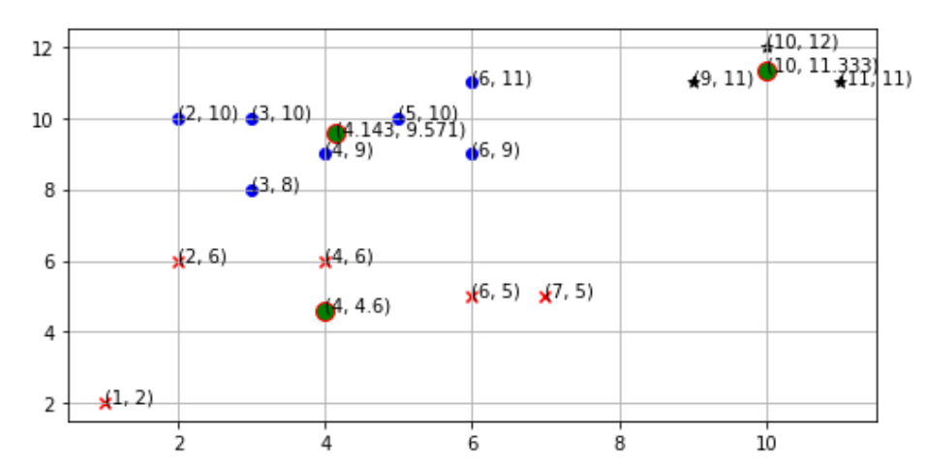
If we plot the clusters on a graph, the graph looks like as follows
Plot for K-Means Clustering
39

Slide 43



Limitations
K-means clustering needs the number of clusters to be specified.
K-means has problems when clusters are of differing sized, densities, and non- globular shapes.
Presence of outlier can skew the results.
40

Slide 44
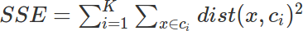
How many Clusters?
Elbow Method:
First of all, compute the sum of squared error (SSE) for some values of k (for example 2, 4, 6, 8, etc.). The SSE is defined as the sum of the squared distance between each member of the cluster and its centroid. Mathematically:
41

Slide 45
How many Clusters?
If you plot k against the SSE, you will see that the error decreases as k gets larger; this is because when the number of clusters increases, they should be smaller, so distortion is also smaller. The idea of the elbow method is to choose the k at which the SSE decreases abruptly. This produces an "elbow effect" in the graph
42

Slide 46
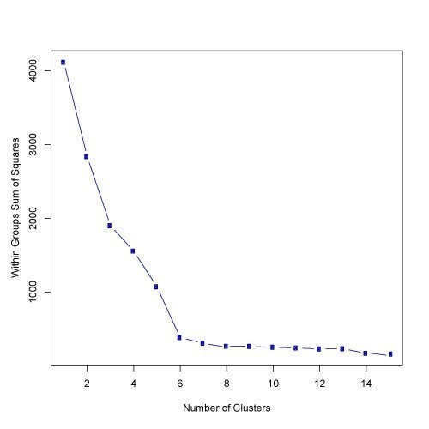
How many Clusters?
43
In this case, k=6 is the value that the Elbow method has selected.

Slide 47
KMeans(n_clusters=5, init='k-means++', max_iter=300, n_init=10, random_state=0)
Parameter Breakdown:
n_clusters=5:
This specifies the number of clusters (or groups) you want the algorithm to form. In this case, you're asking the KMeans algorithm to find 5 clusters.
init='k-means++':
This defines the method for initializing the centroids of the clusters. 'k-means++' is a smart centroid initialization technique that helps the algorithm converge faster and better than random initialization. It chooses initial cluster centers that are far apart, reducing the chances of poor clustering.
max_iter=300:
This sets the maximum number of iterations for a single run of the KMeans algorithm. KMeans repeats a process of assigning points to clusters and then updating the cluster centroids. If the centroids don’t stabilize (i.e., stop moving) before hitting 300 iterations, the algorithm will stop anyway.
n_init=10:
KMeans is a randomized algorithm, meaning that depending on the initial placement of centroids, you may get different clustering results. n_init=10 means the algorithm will run 10 different initializations of the centroids and pick the one with the lowest inertia (sum of squared distances of samples to their closest cluster center). This makes the results more reliable.
random_state=0:
This is used to control the randomness of centroid initialization. By specifying a random_state, the algorithm will produce the same results every time you run it with the same data. It’s useful for reproducibility, especially when you want consistent results across multiple runs of the algorithm.
44

Slide 48
Hands On
k_means.ipynb
https://drive.google.com/file/d/1Nx6PQIo6d-Lh2y7VAisIPQiLRkfdgPaj/view?usp=sharing
45

Slide 49
DBSCAN
Steps of DBSCAN:
Start with an unvisited point and determine if it is a core point (i.e., if it has enough neighboring points within eps).
If it is a core point, form a cluster around it, and recursively check all of its neighbors.
If it is not a core point and does not belong to any cluster, it is considered noise.
Repeat the process for all points until every point has been visited and either assigned to a cluster or marked as noise.
#model = DBSCAN(eps=0.5, min_samples=5
Explanation of the Parameters:
eps=0.5:
This is the maximum distance between two points for them to be considered as part of the same neighborhood (i.e., to be "densely connected").
If the distance between two points is less than or equal to eps, they are considered as neighbors.
min_samples=5:
This defines the minimum number of points required to form a dense region, which constitutes a cluster.
A point is considered a core point if at least min_samples points (including the point itself) are within its eps neighbourhood.
46

Slide 50
Hands On
DBSCAN.ipynb
Code:
https://drive.google.com/file/d/1ttq8wDofHojD7WCCI41sukho9GVqvby9/view?usp=sharing
Solved problem:
https://drive.google.com/file/d/1n9pBk2iCDcDmBxIXYrFkxRr26zghd3ey/view?usp=sharing
45

Slide 51
Supervised Learning

Slide 52
An application of Supervised learning
Endless applications of supervised learning.
An emergency room in a hospital measures 17 variables (e.g., blood pressure, heart rate, etc) of newly admitted patients.
A decision is needed: whether to put a new patient in an intensive-care unit (ICU).
Due to the high cost of ICU, those patients who may survive less than a month are given higher priority.
Problem: to predict high-risk patients and discriminate them from low-risk patients.
46

Slide 53
Another application
A credit card company receives thousands of applications for new cards. Each application contains information about an applicant,
age
annual salary
outstanding debts
credit rating
etc.
Problem: Decide whether an application should approved, i.e., classify applications into two categories, approved and not approved.
47

Slide 54
Supervised Machine Learning
We humans learn from past experiences.
A computer does not “experience.”
A computer system learns from data, which represents “past experiences” in an application domain.
Our focus: learn a target function that can be used to predict the values (labels) of a discrete class attribute, e.g.,
high-risk or low risk and approved or not-approved.
The task is commonly called: supervised learning, classification, or inductive learning.
48

Slide 55
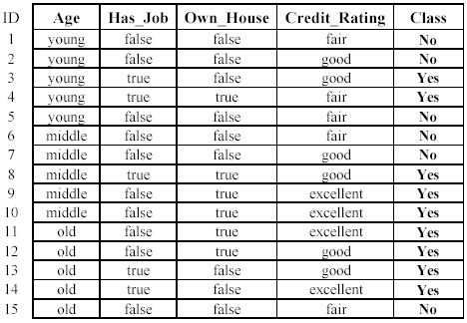
An example: data (loan application)
Approved or not
49

Slide 56
An example: the learning task
Sub-tasks:
Learn a classification model from the data
Use the model to classify future loan applications into
Yes (approved) and
No (not approved)
What is the class for following applicant/case?
50

Slide 57
The data and the goal
Data: A set of data records (also called examples, instances, or cases) described by
k data attributes: A₁, A₂, … A_{k}.
One class attribute: a set of pre-defined class labels
In other words, each record/example is labelled with a class label.
Goal: To learn a classification model from the data that can be used to predict the classes of new (future or test) instances/cases.
51

Slide 58
Supervised vs. Unsupervised Learning
Supervised learning: classification is supervised learning from examples.
Supervision: The data (observations, measurements, etc.) are labeled with pre-defined classes, which is
like a “teacher” gives us the classes (supervision).
Unsupervised learning (clustering)
Class labels of the data are not given or unknown
Goal: Given a set of data, the task is to establish the existence of classes or clusters in the data
52

Slide 59
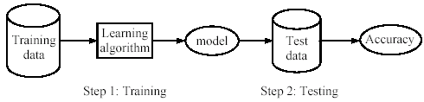
Supervised Learning process; two steps
Learning or training: Learn a model using the training data (with labels)
Testing: Test the model using unseen test data (without labels) to assess the model accuracy
53

Slide 60
What do mean by learning?
Given
a data set D,
a task T, and
a performance measure M,
A computer system is said to learn from D to perform the task T,
if after learning, the system’s performance on T improves as measured by M.
In other words, the learned model helps the system to perform T better as compared to without learning.
54

Slide 61
An example
Data: Loan application data
Task: Predict whether a loan should be approved or not.
Performance measure: accuracy.
No learning: classify all future applications (test data) to the majority class (i.e., Yes):
Pr(Yes) = 9/15 = 60%.
Expected accuracy = 60%.
Can we do better (> 60%) with learning?
55

Slide 62
Decision Tree

Slide 63
What is Decision Tree?
Decision trees are a popular and powerful tool used in various fields such as machine learning, data mining, and statistics.
They provide a clear and intuitive way to make decisions based on data by modeling the relationships between different variables.
A decision tree is a flowchart-like structure used to make decisions or predictions.
It consists of nodes representing decisions or tests on attributes, branches representing the outcome of these decisions, and leaf nodes representing final outcomes or predictions.
Each internal node corresponds to a test on an attribute, each branch corresponds to the result of the test, and each leaf node corresponds to a class label or a continuous value.
56

Slide 64
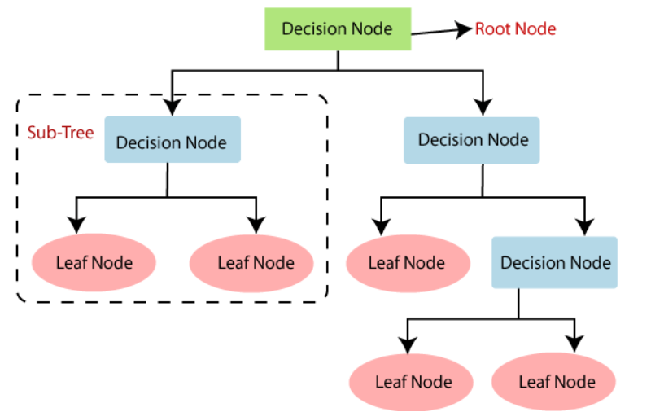
Structure of a Decision Tree
Root Node: Represents the entire dataset and the initial decision to be made.
Internal Nodes: Represent decisions or tests on attributes. Each internal node has one or more branches.
Branches: Represent the outcome of a decision or test, leading to another node.
Leaf Nodes: Represent the final decision or prediction. No further splits occur at these nodes.
57

Slide 65
How Decision Tree work?
The process of creating a decision tree involves:
Selecting the Best Attribute: Using a metric like Gini impurity, entropy, or information gain, the best attribute to split the data is selected.
Splitting the Dataset: The dataset is split into subsets based on the selected attribute.
Repeating the Process: The process is repeated recursively for each subset, creating a new internal node or leaf node until a stopping criterion is met (e.g., all instances in a node belong to the same class or a predefined depth is reached).
58

Slide 66
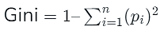
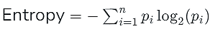
Metrics for Splitting
Gini Impurity: Measures the likelihood of an incorrect classification of a new instance if it was randomly classified according to the distribution of classes in the dataset.
where pi​ is the probability of an instance being classified into a particular class.
Entropy: Measures the amount of uncertainty or impurity in the dataset.
where pi​ is the probability of an instance being classified into a particular class.
Information Gain: Measures the reduction in entropy or Gini impurity after a dataset is split on an attribute.
where Di​ is the subset of D after splitting by an attribute.
59

Slide 67
Applications of Decision Trees
Python Decision trees are versatile tools with a wide range of applications in machine learning:
Classification: Making predictions about categorical results, like if an email is spam or not.
Regression: The estimation of continuous values; for example, feature-based home price prediction.
Feature Selection: Feature selection lowers dimensionality and boosts model performance by determining which features are most pertinent to a certain job.
60

Slide 68
Variants of Decision Tree Algorithms
The most used decision tree algorithms are :
ID3 (Iterative Dichotomiser 3)
C4.5
CART(classification and regression trees) --
The algorithm id3 uses ‘information Gain’ as the splitting criterion whereas the algorithm c4.5 uses ‘ gain ratio as the splitting criterion.
The cart algorithm is popularly used for classifying both categorical and continuous- valued target variables. Cart uses Gini index to construct a decision tree.
61

Slide 69
ID3 Tree Construction
An approach for decision trees called ID3 (Iterative Dichotomiser 3) is employed in classification applications.
It is one of the first and most used decision tree algorithms, created by Ross Quinlan in 1986. The ID3 algorithm builds a decision tree from a given dataset using a greedy, top-down methodology.
It works by greedily choosing the feature that maximizes the information gain at each node.
ID3 calculates entropy and information gain for each feature and selects the feature with the highest information gain for splitting.
ID3 uses entropy to measure the uncertainty or disorder in a dataset. Entropy, denoted by H(D) for dataset D, is calculated using the formula:
Information gain quantifies the reduction in entropy achieved by splitting the data based on a particular feature. Features with higher information gain are preferred for splitting. Information gain is calculated as follows:
Every decision tree node’s dataset is recursively divided using the ID3 algorithm according to the chosen attribute. This method keeps going until either there are no more attributes to divide on, or all the examples in a node belong to the same class.
62

Slide 70
Solved Example
Example 1: Let us look at a simple example of constructing a decision tree with the training dataset consisting of 10 data instances and 3 attributes {A1, A2, A3} as shown in Table 1. The final attribute in the dataset is the target class to be classified. Each row in the table is called a data instance. The data instances are classified as 'Positive' or 'Negative'. Construct the decision tree and predict the target class for a given test instance.
S.No. | A1 | A2 | A3 | Target Class
1 | 10 | 0.5 | 2.5 | Negative
2 | 7 | 1.3 | 3 | Positive
3 | 5 | 0.7 | 5.6 | Negative
4 | 9 | 1.0 | 4.3 | Positive
5 | 10 | 1.2 | 7.1 | Positive
6 | 8 | 0.9 | 6.5 | Negative
7 | 6 | 0.8 | 3.2 | Negative
8 | 4 | 1.5 | 5.1 | Negative
9 | 9 | 1.7 | 4.7 | Positive
10 | 8 | 1.6 | 7.4 | Positive
63
Table 1

Slide 71
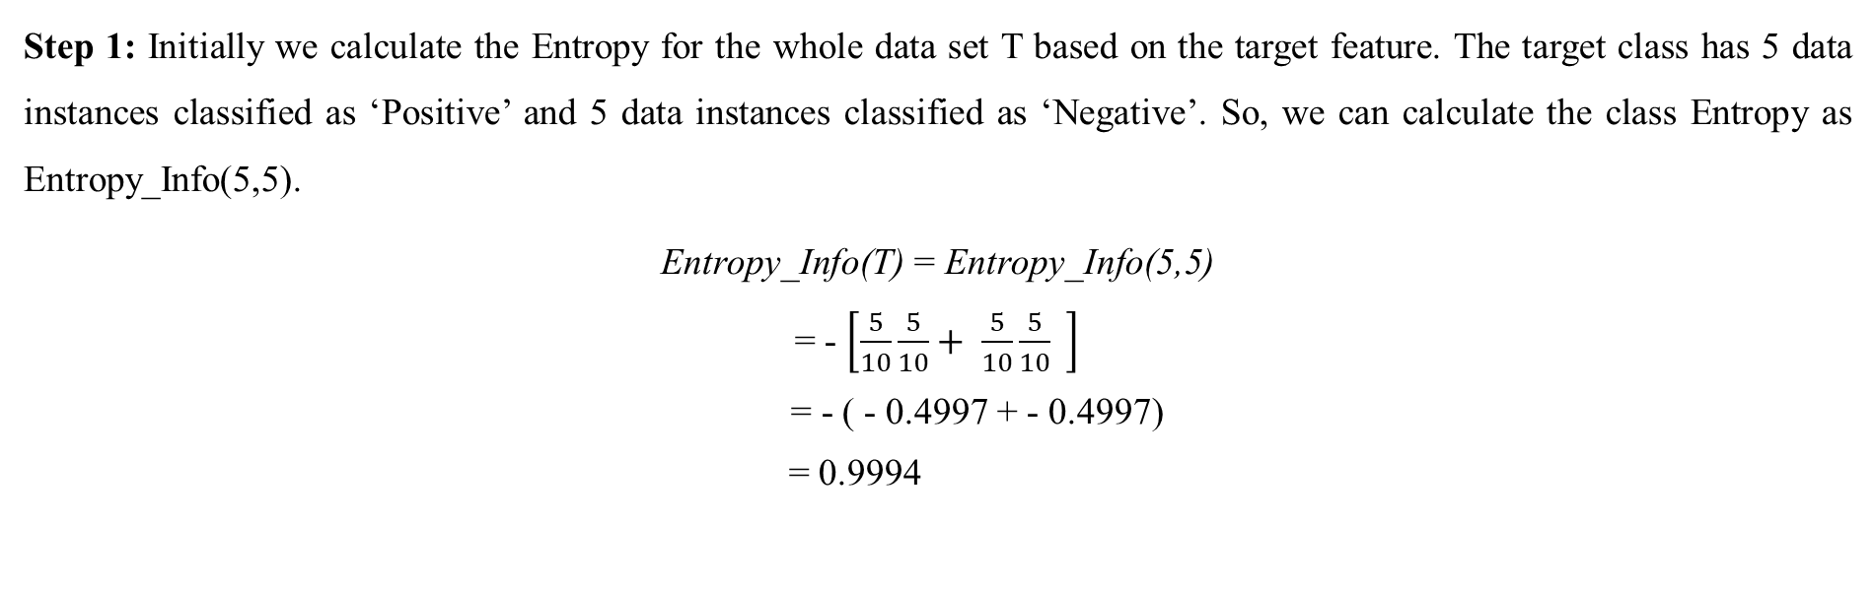
Solution:
Table 2 depicts the number of data instances categorized as Positive or Negative for each of the three attributes in the Training dataset.
Table 2
A1 | Positive | Negative | Total | A2 | Positive | Negative | Total | A3 | Positive | Negative | Total
≥ 5 < 5 | 5 0 | 4 1 | 9 1 | ≥ 1 < 1 | 5 0 | 1 4 | 6 4 | ≥ 5 < 5 | 2 3 | 3 2 | 5 5
Step 1: Initially we calculate the Entropy for the whole data set T based on the target feature. The target class has 5 data instances classified as ‘Positive’ and 5 data instances classified as ‘Negative’. So, we can calculate the class Entropy as Entropy_Info(5,5).
Entropy_Info(T) = Entropy_Info(5,5)
= - $\left[\frac{5}{10}\frac{5}{10}+ \frac{5}{10}\frac{5}{10} \right]$
= - ( - 0.4997 + - 0.4997)
= 0.9994
64

Slide 72
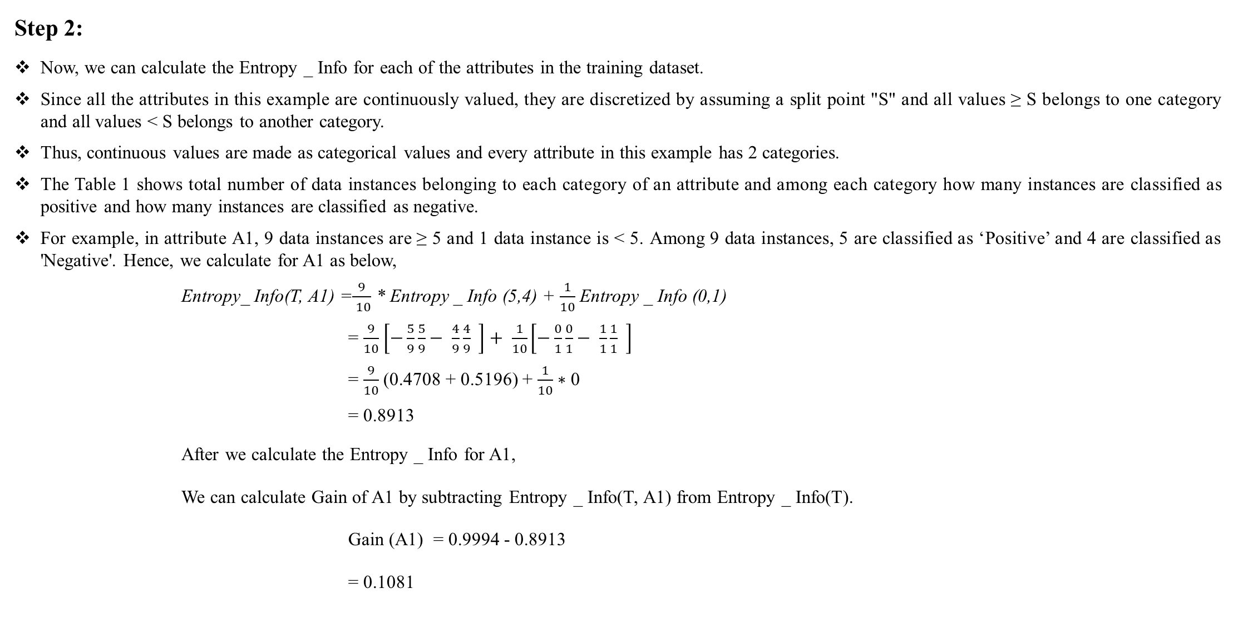
Step 2:
Now, we can calculate the Entropy _ Info for each of the attributes in the training dataset.
Since all the attributes in this example are continuously valued, they are discretized by assuming a split point "S" and all values ≥ S belongs to one category and all values < S belongs to another category.
Thus, continuous values are made as categorical values and every attribute in this example has 2 categories.
The Table 1 shows total number of data instances belonging to each category of an attribute and among each category how many instances are classified as positive and how many instances are classified as negative.
For example, in attribute A1, 9 data instances are ≥ 5 and 1 data instance is < 5. Among 9 data instances, 5 are classified as ‘Positive’ and 4 are classified as 'Negative'. Hence, we calculate for A1 as below,
Entropy_ Info(T, A1) =$\frac{9}{ 10}$ * Entropy _ Info (5,4) + $\frac{1}{10}$ Entropy _ Info (0,1)
= $\frac{9}{10}$ $\left[−\frac{5}{9}\frac{5}{9}− \frac{4}{9}\frac{4}{9} \right]+ \frac{1}{10}\left[−\frac{0}{1}\frac{0}{1}− \frac{1}{1}\frac{1}{1} \right]$
= $\frac{9}{10}$ (0.4708 + 0.5196) + $\frac{1}{10}∗$ 0
= 0.8913
After we calculate the Entropy _ Info for A1,
We can calculate Gain of A1 by subtracting Entropy _ Info(T, A1) from Entropy _ Info(T).
Gain (A1) = 0.9994 - 0.8913
= 0.1081
65

Slide 73
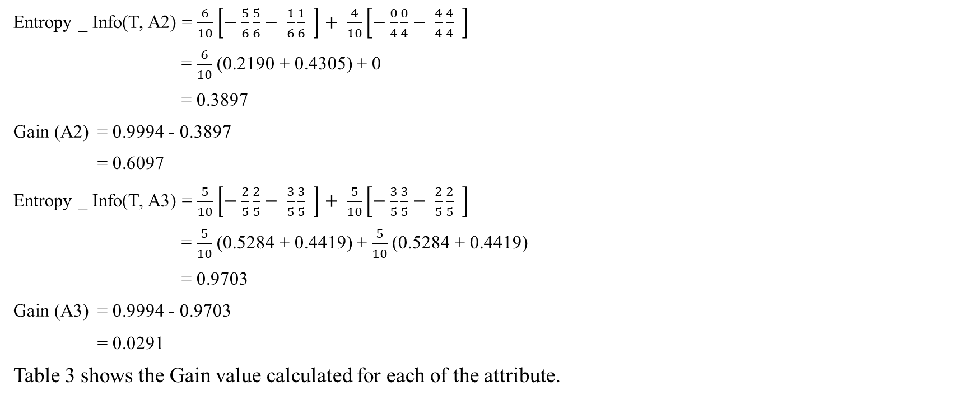
Entropy _ Info(T, A2) = $\frac{6}{10}$ $\left[−\frac{5}{6}\frac{5}{6}− \frac{1}{6}\frac{1}{6} \right]+ \frac{4}{10}\left[−\frac{0}{4}\frac{0}{4}− \frac{4}{4}\frac{4}{4} \right]$
= $\frac{6}{10}$ (0.2190 + 0.4305) + 0
= 0.3897
Gain (A2) = 0.9994 - 0.3897
= 0.6097
Entropy _ Info(T, A3) = $\frac{5}{10}$ $\left[−\frac{2}{5}\frac{2}{5}− \frac{3}{5}\frac{3}{5} \right]+ \frac{5}{10}\left[−\frac{3}{5}\frac{3}{5}− \frac{2}{5}\frac{2}{5} \right]$
= $\frac{5}{10}$ (0.5284 + 0.4419) + $\frac{5}{10}$ (0.5284 + 0.4419)
= 0.9703
Gain (A3) = 0.9994 - 0.9703
= 0.0291
Table 3 shows the Gain value calculated for each of the attribute.
Table 3
Attribute | Gain
A1 | 0.1081
A2 | 0.6097
A3 | 0.0291
66

Slide 74
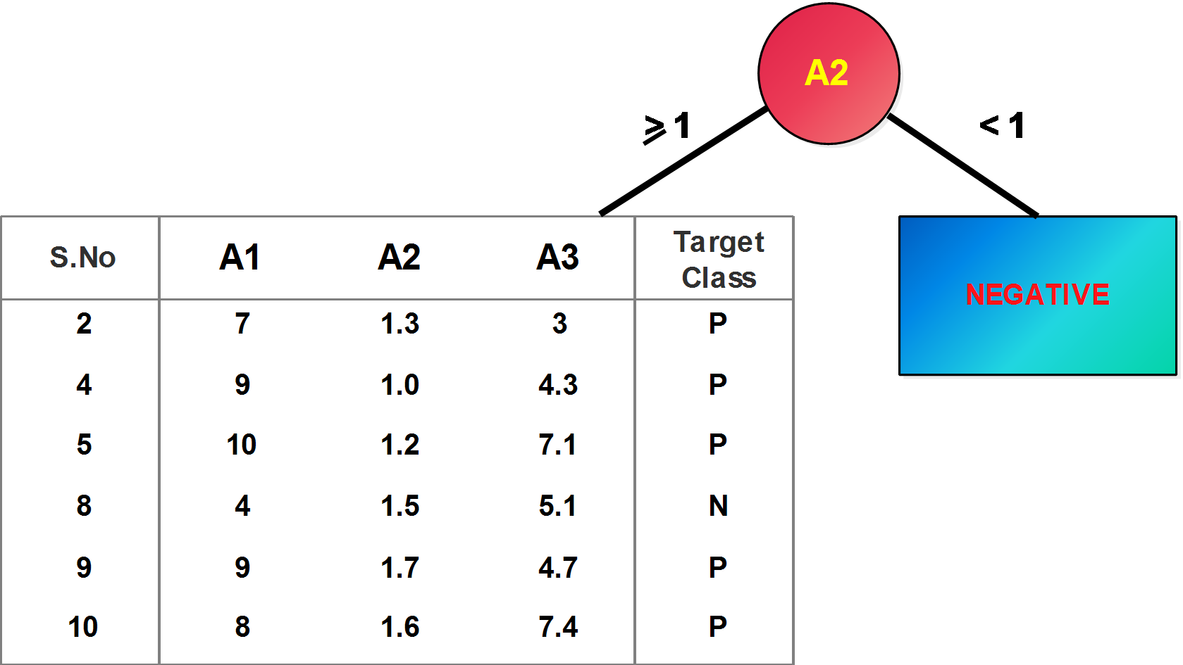
Step 3:
Now we choose the attribute which has maximum gain as the best split attribute. Here we choose A2 as the best split attribute and place it as the root node. A2 has two outcomes ≥ 1 and < 1.
Table 4 shows the data instances for which A2 values are < 1 and all are categorized as ‘Negative’ and hence its entropy is 0. So, the outcome of A2 with < 1 ends up in a leaf node and its class is ‘Negative’.
All other data instances with A2 values ≥ 1 form another subset and the process is repeated. This is shown in Figure 1.
Table 4
S.No | A1 | A2 | A3 | Target Class
1 | 10 | 0.5 | 2.5 | Negative
3 | 5 | 0.7 | 5.6 | Negative
6 | 8 | 0.9 | 6.5 | Negative
7 | 6 | 0.8 | 3.2 | Negative
67

Slide 75
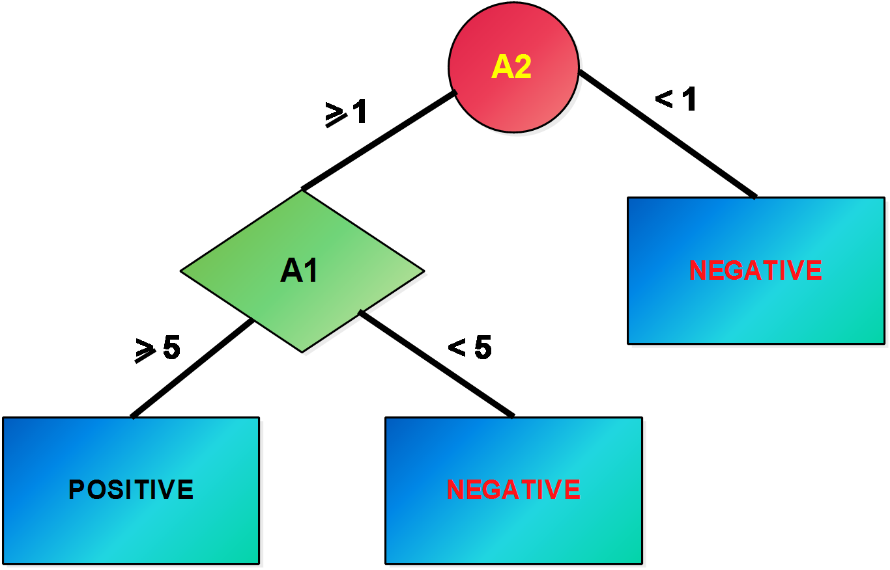
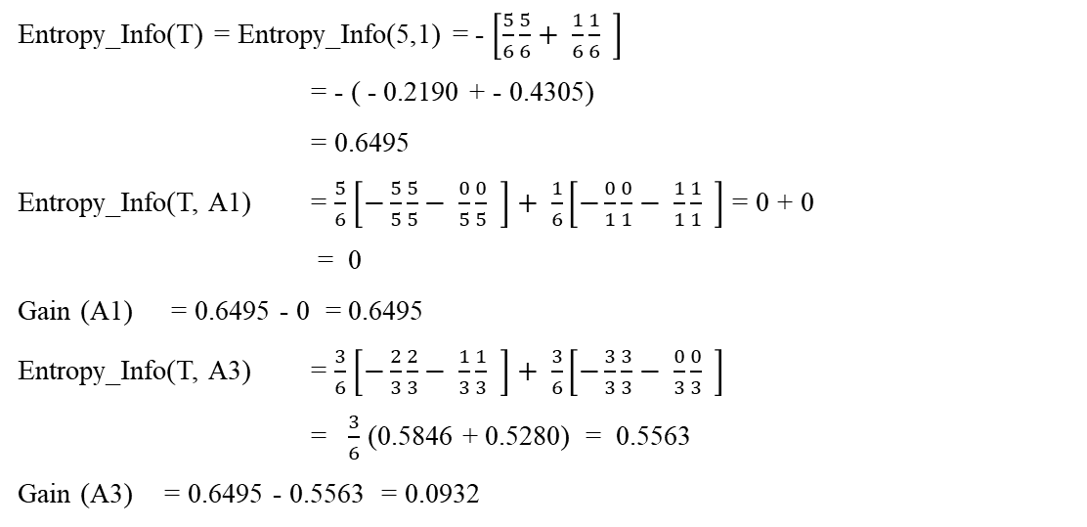
Table 5 depicts the number of data instances categorized as Positive and Negative for the attributes A1 and A3.
Table 5
Table 6
A1 | Positive | Negative | Total | A3 | Positive | Negative | Total
≥ 5 < 5 | 5 0 | 0 1 | 5 1 | ≥ 5 < 5 | 2 3 | 1 0 | 3 3
Attribute | Gain
A1 | 0.6495
A3 | 0.0932
Entropy_Info(T) = Entropy_Info(5,1) = - $\left[\frac{5}{6}\frac{5}{6}+ \frac{1}{6}\frac{1}{6} \right]$
= - ( - 0.2190 + - 0.4305)
= 0.6495
Entropy_Info(T, A1) = $\frac{5}{6}$ $\left[−\frac{5}{5}\frac{5}{5}− \frac{0}{5}\frac{0}{5} \right]+ \frac{1}{6}\left[−\frac{0}{1}\frac{0}{1}− \frac{1}{1}\frac{1}{1} \right]$ = 0 + 0
= 0
Gain (A1) = 0.6495 - 0 = 0.6495
Entropy_Info(T, A3) = $\frac{3}{6}$ $\left[−\frac{2}{3}\frac{2}{3}− \frac{1}{3}\frac{1}{3} \right]+ \frac{3}{6}\left[−\frac{3}{3}\frac{3}{3}− \frac{0}{3}\frac{0}{3} \right]$
= $\frac{3}{6}$ (0.5846 + 0.5280) = 0.5563
Gain (A3) = 0.6495 - 0.5563 = 0.0932
Figure 2
The final decision tree is shown in Figure 2. Now if a test instance is given, the target class can be predicted. The sample test instance is given as (6, 1, 6.7). Now, traverse the tree for the given test data instance from root to leaf taking a path that satisfies the constraints. The predicted class label is ‘Positive’.
As shown in Table 6, A1with the maximum information gain is chosen as the best split attribute.
The outcome of A1 ≥ 5 has 5 instances in the subset considered in Iteration 2 and are all 'Positive' and entropy is 0.
Hence it ends in a leaf node as ‘Positive’. There is 1 instance < 5 and classified as ‘Negative’.
68

Slide 76
Table 5 depicts the number of data instances categorized as Positive and Negative for the attributes A1 and A3.
Table 5
Table 6
A1 | Positive | Negative | Total | A3 | Positive | Negative | Total
≥ 5 < 5 | 5 0 | 0 1 | 5 1 | ≥ 5 < 5 | 2 3 | 1 0 | 3 3
Attribute | Gain
A1 | 0.6495
A3 | 0.0932
Entropy_Info(T) = Entropy_Info(5,1) = - $\left[\frac{5}{6}\frac{5}{6}+ \frac{1}{6}\frac{1}{6} \right]$
= - ( - 0.2190 + - 0.4305)
= 0.6495
Entropy_Info(T, A1) = $\frac{5}{6}$ $\left[−\frac{5}{5}\frac{5}{5}− \frac{0}{5}\frac{0}{5} \right]+ \frac{1}{6}\left[−\frac{0}{1}\frac{0}{1}− \frac{1}{1}\frac{1}{1} \right]$ = 0 + 0
= 0
Gain (A1) = 0.6495 - 0 = 0.6495
Entropy_Info(T, A3) = $\frac{3}{6}$ $\left[−\frac{2}{3}\frac{2}{3}− \frac{1}{3}\frac{1}{3} \right]+ \frac{3}{6}\left[−\frac{3}{3}\frac{3}{3}− \frac{0}{3}\frac{0}{3} \right]$
= $\frac{3}{6}$ (0.5846 + 0.5280) = 0.5563
Gain (A3) = 0.6495 - 0.5563 = 0.0932
Figure 2
The final decision tree is shown in Figure 2. Now if a test instance is given, the target class can be predicted. The sample test instance is given as (6, 1, 6.7). Now, traverse the tree for the given test data instance from root to leaf taking a path that satisfies the constraints. The predicted class label is ‘Positive’.
As shown in Table 6, A1with the maximum information gain is chosen as the best split attribute.
The outcome of A1 ≥ 5 has 5 instances in the subset considered in Iteration 2 and are all 'Positive' and entropy is 0.
Hence it ends in a leaf node as ‘Positive’. There is 1 instance < 5 and classified as ‘Negative’.
69

Slide 77
HANDS ON Refer: Decision_Trees.ipynb
https://colab.research.google.com/drive/1VU3G-HN7WlfJj8wEVxkPpyUrp3iJOc5Y?usp=sharing
70

Slide 78
Reinforcement Learning

Slide 79
Introduction to Reinforcement Learning
Supervised learning
classification, regression
Unsupervised learning
clustering
Reinforcement learning
more general than supervised/unsupervised learning
learn from interaction w/ environment to achieve a goal
environment
reward
new state
71
action
agent

Slide 80
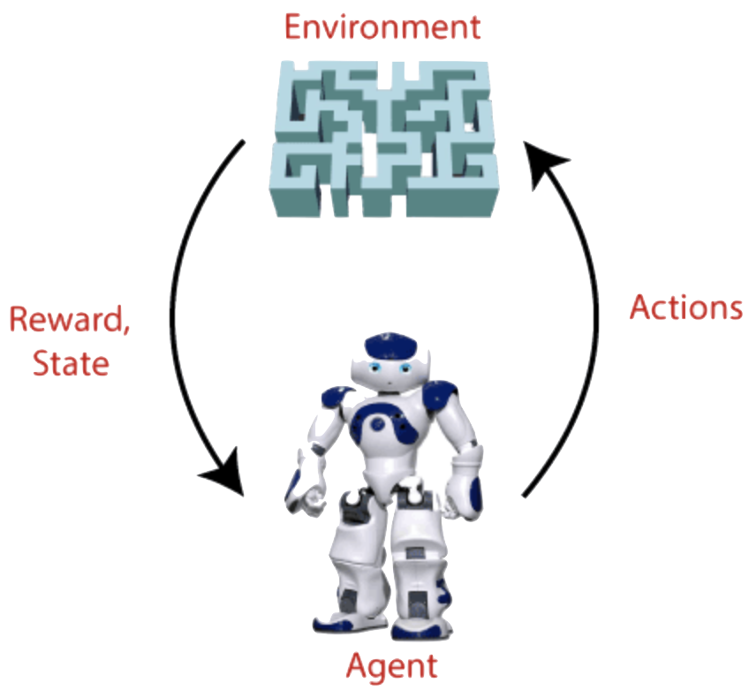
What is Reinforcement Learning?
Reinforcement learning is a type of machine learning method where an intelligent agent interacts with the environment and learns to act within that.
For each good action, the agent gets positive feedback, and for each bad action, the agent gets negative feedback or penalty.
RL solves a specific type of problem where decision making is sequential, and the goal is long-term.
The agent continues doing following three things:
Take action,
change state/remain in the same state
get feedback
By doing these actions, he learns and explores the environment.
72

Slide 81
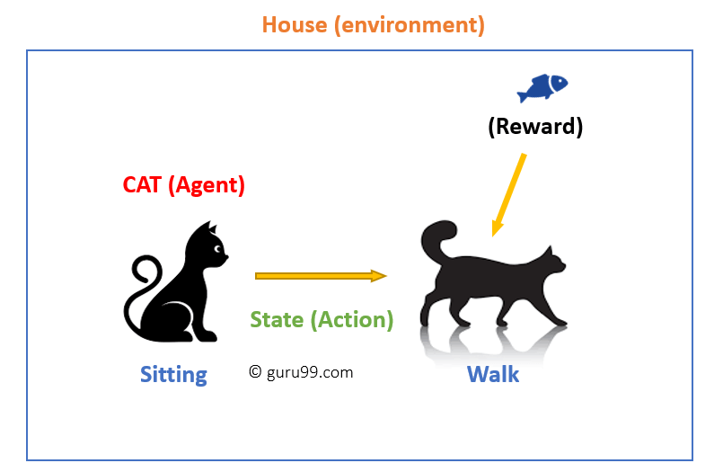
Reinforcement Learning Example
An example of a state could be your cat sitting, and you use a specific word for cat to walk.
Your cat reacts by performing an action transition from one “state” (sitting) to another “state” (walking).
The reaction of your cat is an action, and the policy is a method of selecting an action given a state in expectation of better outcomes.
After the transition, cat may get a reward or penalty in return.
73

Slide 82
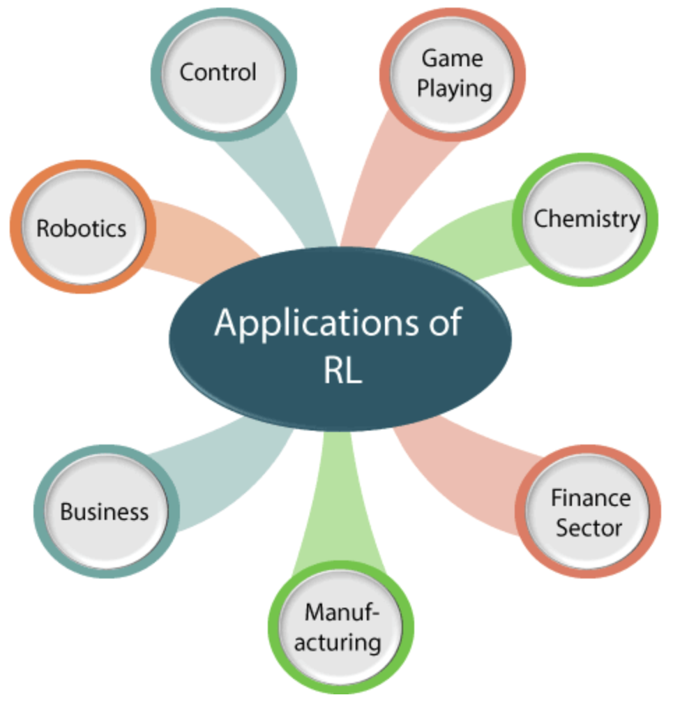
Reinforcement Learning Appliction
74

Slide 83



Supervised Vs Unsupervised Vs
Reinforcement Learning
Criteria | Supervised ML | Unsupervised ML | Reinforcement ML
Definition | Learns by using labelled data | Trained using unlabelled data without any guidance. | Works on interacting with the environment
Type of problems | Regression and classification | Association and Clustering | Exploitation or Exploration
Algorithms | Linear Regression, Logistic Regression, SVM, KNN etc. | K – Means, C – Means, Apriori | Q – Learning, SARSA
Aim | Calculate outcomes | Discover underlying patterns | Learn a series of action
Application | Risk Evaluation, Forecast Sales | Recommendation System, Anomaly Detection | Self Driving Cars, Gaming, Healthcare
75

Slide 84
Term Used in Reinforcement Learning
Agent
An entity that can perceive/explore the environment and act upon it.
Environment
A situation in which an agent is present or surrounded by.
Action
Actions are the moves taken by an agent within the environment.
State
State is a situation returned by the environment after each action taken by the agent.
Reward
A feedback returned to the agent from the environment to evaluate the action of the agent.
Policy
Policy is a strategy applied by the agent for the next action based on the current state.
Value
It is expected long-term retuned with the discount factor and opposite to the short-term reward.
76

Slide 85
Elements of Reinforcement Learning
There are four main elements of Reinforcement Learning, which are given below
1. Policy:
A policy can be defined as a way how an agent behaves at a given time. It maps the perceived states of the environment to the actions taken on those states.
The policy-based approach has mainly two types of policy:
Deterministic: The same action is produced by the policy (π) at any state.
Stochastic: In this policy, probability determines the produced action.
2. Reward Signal: The goal of RL is defined by the reward signal. Reward signals are given according to the good and bad actions taken by the learning agent. The main objective is to maximize the total number of rewards for good actions.
3. Value Function: Gives information about how good the situation and action are and how much reward an agent can expect.
4. Model: Mimics the behavior of the environment.
77

Slide 86
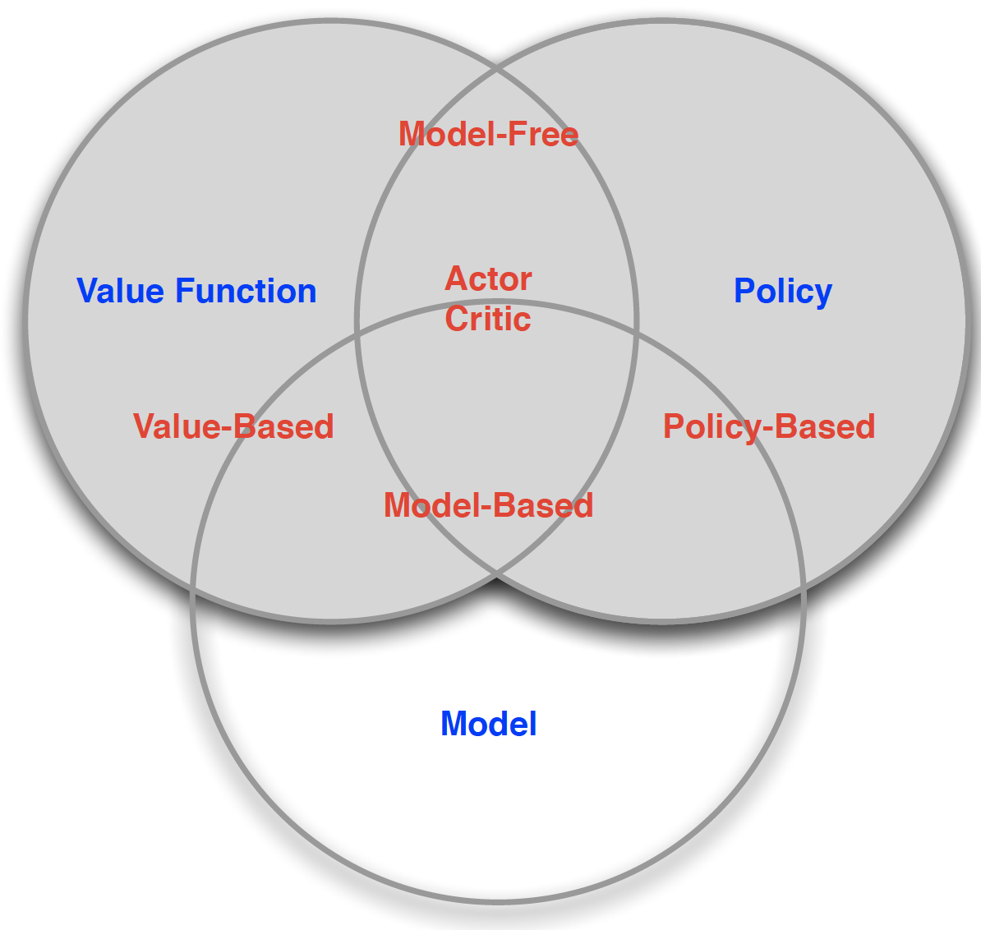
Reinforcement Learning Categories
Value Based
No Policy
Value Function
Policy Based
Policy
No Value Function
Actor Critic
Policy
Value Function
Model Free
Policy and/or Value Function
No Model
Model Based
Policy and/or Value Function
Model
78

Slide 87
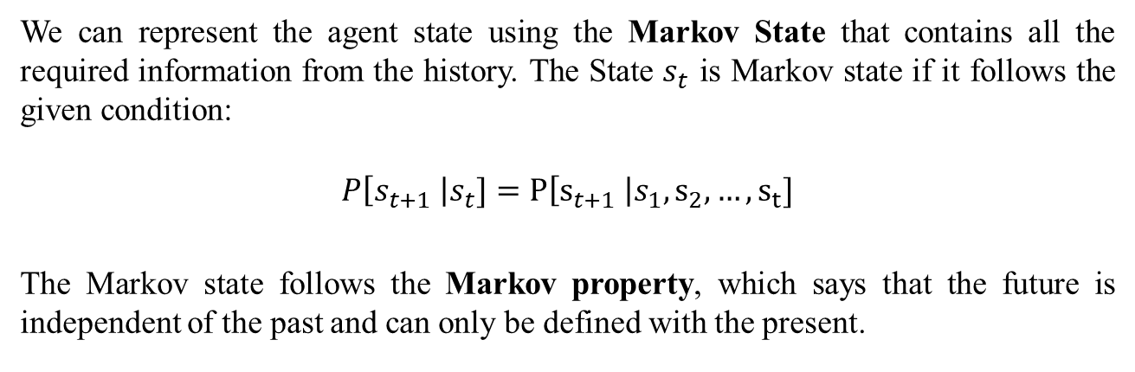
State Representation
We can represent the agent state using the Markov State that contains all the required information from the history. The State $s_{t}$ is Markov state if it follows the given condition:
$$P\left[s_{t+1} \right|s_{t}]=P\left[s_{t+1} \right|s_{1}, s_{2}, …, s_{t}]$$
The Markov state follows the Markov property, which says that the future is independent of the past and can only be defined with the present.
The RL works on fully observable environments, where the agent can observe the environment and act for the new state. The complete process is known as Markov Decision process.
79

Slide 88
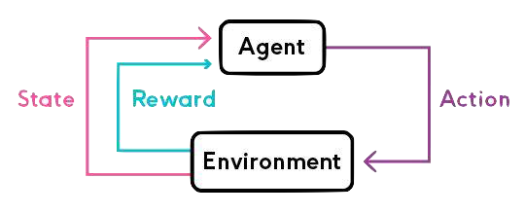
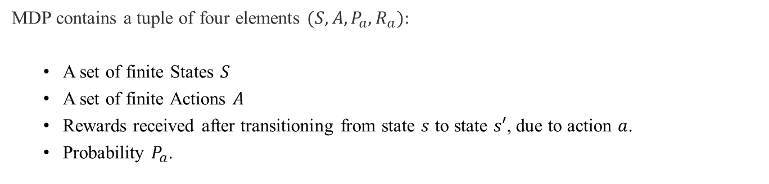
Markov Decision Process
Markov Decision Process or MDP, is used to formalize the Reinforcement Learning problems.
MDP contains a tuple of four elements $(S, A,P_{a}, R_{a}):$
A set of finite States $S$
A set of finite Actions $A$
Rewards received after transitioning from state $s$ to state $s′$, due to action $a$.
Probability $P_{a}$.
80

Slide 89
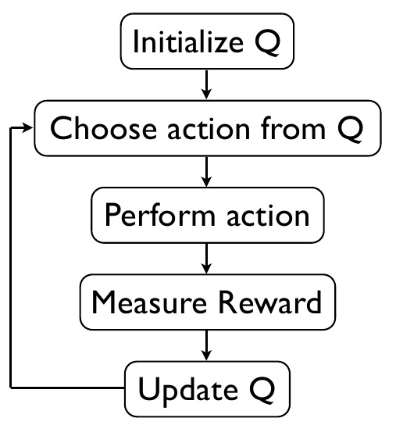
Reinforcement Learning Algorithms
RL algorithms are mainly used in AI applications and gaming applications. The main used algorithm is:
Q-Learning:
Q-learning is a popular model-free Reinforcement Learning algorithm based on the Bellman equation $V\left(s\right)= \max_{a}{(R\left(s, a\right)+γV(s′))}$.
Q-learning is a popular model-free Reinforcement Learning algorithm based on the Bellman equation 𝑉(𝑠)= max_𝑎⁡〖(𝑅(𝑠, 𝑎)+𝛾𝑉(𝑠′))〗.
The main objective of Q-learning is to learn the policy which can inform the agent that what actions should be taken for maximizing the reward under what circumstances.
It is an off-policy RL that attempts to find the best action to take at a current state.
81
$$Q_{new}\left(s_{t}, a_{t}\right)= Q\left(s_{t}, a_{t}\right)+α × (r_{t} +γ × max_{a} Q(s_{t+1}, a) − Q(s_{t}, a_{t}))$$

Slide 90
🔹 Applications of Reinforcement Learning in Defense
Autonomous Drones & UAVs
Path planning and obstacle avoidance in hostile environments.
Coordinated swarm intelligence for surveillance and attack.
Robotics & Autonomous Vehicles
Unmanned ground vehicles (UGVs) for reconnaissance and logistics.
RL-based navigation in GPS-denied or adversarial conditions.
82

Slide 91
Hands-on:
https://colab.research.google.com/drive/1mBQHsGQ0OcjeArqbKQX8evbhcba2NHXJ?usp=sharing
83

Slide 92
Machine Learning (ML)
Pipeline

Slide 93
Main steps of the Machine Learning (ML) pipeline
The ML pipeline is an end-to-end workflow that takes raw data and transforms it into a deployed ML model that continuously learns and improves.
It ensures consistency, automation, reproducibility, and scalability.
Data Collection
Data Preprocessing
Feature Engineering & Selection
Model Selection
Model Training
Model Evaluation
Deployment
Monitoring & Maintenance
84

Slide 94
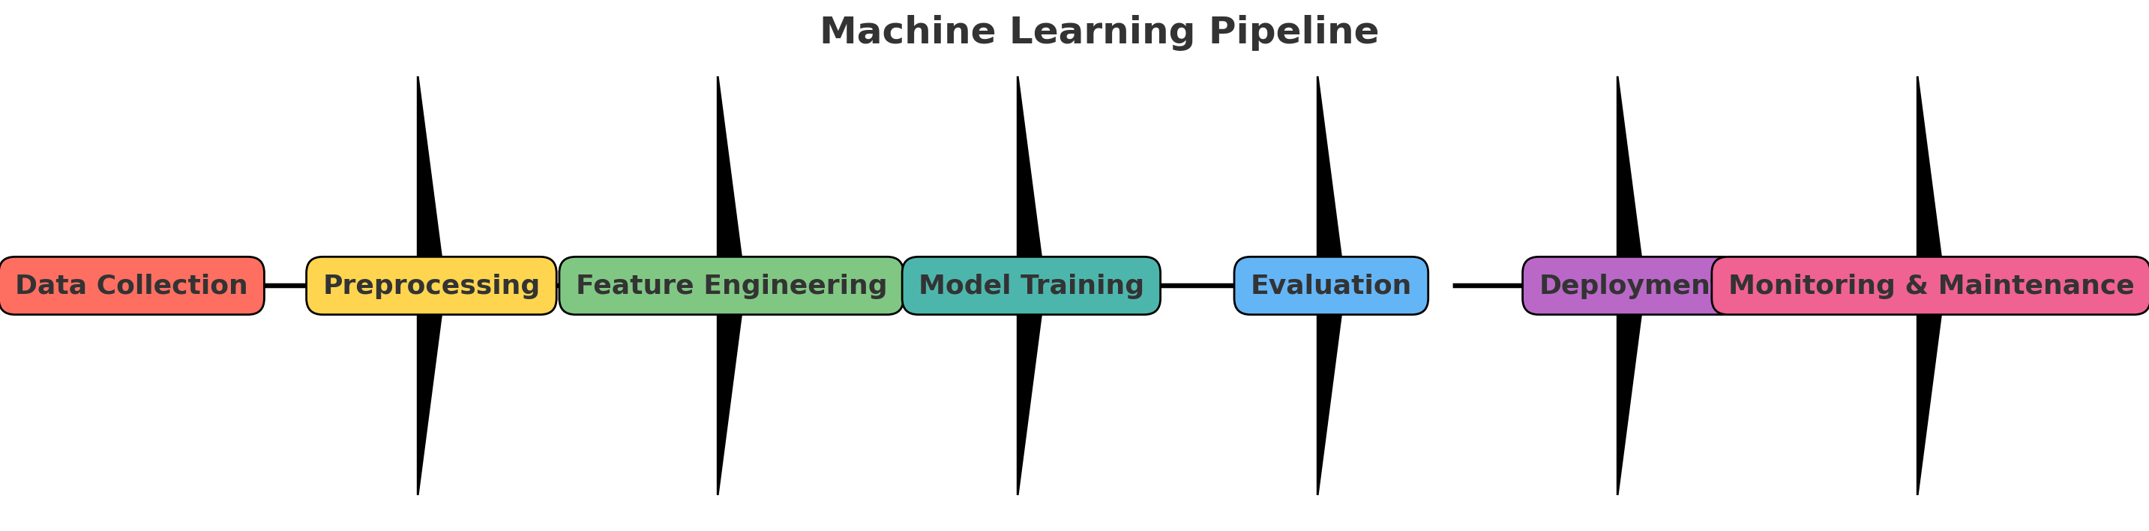
85

Slide 95
Data Collection
Collect raw data from multiple sources such as databases, sensors, APIs, or logs.
Data can be structured (tables, spreadsheets) or unstructured (images, audio, text).
Ensure relevance of collected data to the problem statement and objectives.
Data should be diverse and representative to avoid bias and overfitting.
Sources include IoT devices, social media, medical records, and transaction logs.
Define the scope and goals of data collection before starting the process.
Data quality at this stage directly impacts the overall model performance.
Ethical and legal considerations should be respected (GDPR, HIPAA).
Large datasets enable use of advanced algorithms like deep learning.
Big data involves volume, velocity, and variety of data streams.
86

Slide 96
Data Preprocessing
Handle missing values using imputation, removal, or default strategies.
Remove or correct noisy and inconsistent records in the dataset.
Normalize or standardize numerical features to ensure fair comparison.
Encode categorical data into numerical form using one-hot or label encoding.
Detect and handle outliers that may distort model learning process.
Split dataset into training, validation, and test sets for evaluation.
Balance datasets using oversampling, undersampling, or synthetic data.
Aggregate and merge multiple sources to create a unified dataset.
Data cleaning ensures consistent and accurate model input.
Preprocessing is often the most time-consuming but crucial stage.
87

Slide 97
Feature Engineering
Create new features from raw data that represent underlying relationships.
Transform features for better usability (log, scaling, binning).
Domain knowledge helps design more meaningful features.
Feature selection identifies most important variables.
Reduces dimensionality and improves computational efficiency.
Helps avoid overfitting by eliminating redundant features.
Techniques: correlation analysis, PCA, mutual information scores.
Examples: BMI from height and weight, Age from Date of Birth.
Good features simplify learning and improve accuracy.
Feature engineering is iterative, refined with feedback.
88

Slide 98
Model Training
Choose a suitable machine learning algorithm based on task type.
Train the model using a labeled dataset (supervised learning).
Model learns mappings between features and labels.
Hyperparameters (learning rate, depth, epochs) guide training.
Optimization methods (gradient descent) minimize error.
Cross-validation ensures generalization on unseen data.
Regularization prevents overfitting of the training set.
Large models and datasets require high computational resources.
Save checkpoints during training to track progress.
Training stops when convergence or criteria are met.
89

Slide 99
Model Evaluation
Evaluate performance using a separate test dataset.
Classification metrics: Accuracy, Precision, Recall, F1, AUC-ROC.
Regression metrics: MAE, RMSE, R² score.
Confusion matrix visualizes classification outcomes.
Precision-Recall balance is key in imbalanced data.
Cross-validation offers reliable performance checks.
Check overfitting by comparing training vs test errors.
Evaluate bias, fairness, and interpretability of results.
Performance evaluation validates readiness for deployment.
Poor results require improving features, hyperparameters, or model.
90

Slide 100
Metrics for Performance Evaluation
Focus on the predictive capability of a model
Rather than how fast it takes to classify or build models, scalability, etc.
Confusion Matrix:
 | PREDICTED CLASS
ACTUAL CLASS |  | Class=Yes | Class=No
 | Class=Yes | a: TP | b: FN
 | Class=No | c: FP | d: TN
a: TP (true positive)
b: FN (false negative)
c: FP (false positive)
d: TN (true negative)
91

Slide 101
Metrics for Performance Evaluation
 | PREDICTED CLASS
ACTUAL CLASS |  | Class=Yes | Class=No
 | Class=Yes | a (TP) | b (FN)
 | Class=No | c (FP) | d (TN)
Most widely-used metric:
92

Slide 102
Limitation of Accuracy
Consider a 2-class problem
Number of Class 0 examples = 9990
Number of Class 1 examples = 10
If model predicts everything to be class 0, accuracy is 9990/10000 = 99.9 %
Accuracy is misleading because model does not detect any class 1 example
93

Slide 103
Methods of Estimation
Holdout
Reserve 2/3 for training and 1/3 for testing
Random subsampling
Repeated holdout
Cross validation
Partition data into k disjoint subsets
k-fold: train on k-1 partitions, test on the remaining one
Leave-one-out: k=n
Bootstrap
Sampling with replacement
94

Slide 104
Deployment
Integrate the trained model into real-world systems or apps.
Deployment options: cloud, mobile, embedded, or APIs.
Provide real-time or batch predictions depending on need.
Ensure scalability for high data volume and user demand.
Add monitoring for latency, accuracy, and usage.
Secure deployment to avoid data leaks and adversarial attacks.
Enable feedback loops for retraining when data changes.
Deployment bridges research with production environments.
Continuous updates maintain system reliability.
Successful deployment drives business and social impact.
95

Slide 105
Monitoring & Maintenance
Continuously track model performance after deployment.
Detect concept drift when relationships change over time.
Detect data drift when input statistics differ from training data.
Schedule retraining with fresh data to maintain accuracy.
Set up alerts for accuracy or error thresholds.
Monitor fairness, ethics, and legal compliance in outputs.
Automated pipelines streamline retraining cycles.
Track costs of computation and optimize infrastructure.
Use logging and versioning for transparency.
User feedback is key to improve deployed systems.
96

Slide 106
Hands-on (ML Pipeline)
https://colab.research.google.com/drive/1PyJmB4xU7f9HuIDX_BhTYFyIAZfr8Kq_?usp=sharing
Simulate radar signal classification (friendly vs hostile) and runs a complete ML pipeline using RandomForest (Classification algorithm)
https://colab.research.google.com/drive/1CqoE0qzwdo6V9bizXE1R4q5y6IPP388A?usp=sharing
97

Slide 107
Machine Learning Use Cases in Defense

Slide 108
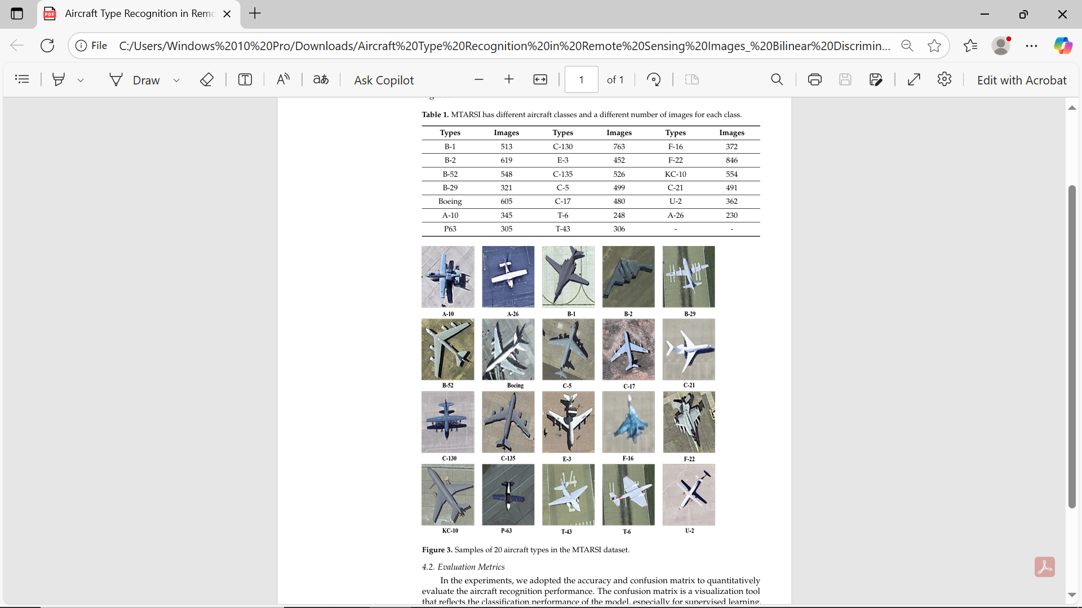
Target Recognition
Type: Supervised
Description: Identifying enemy tanks/aircraft from radar images
Wu, Z.Z.; Wan, S.H.; Wang, X.F.; Tan, M.; Zou, L.; Li, X.L.; Chen, Y.
A benchmark data set for aircraft type recognition from remote sensing images. Appl. Soft Comput. 2020, 89, 106132.
98

Slide 109
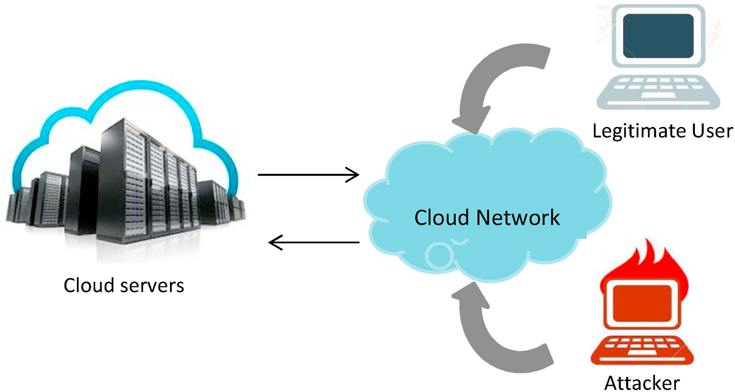
Cybersecurity Intrusion Detection
Type: Unsupervised
Description: Detecting abnormal patterns in network traffic
99

Slide 110
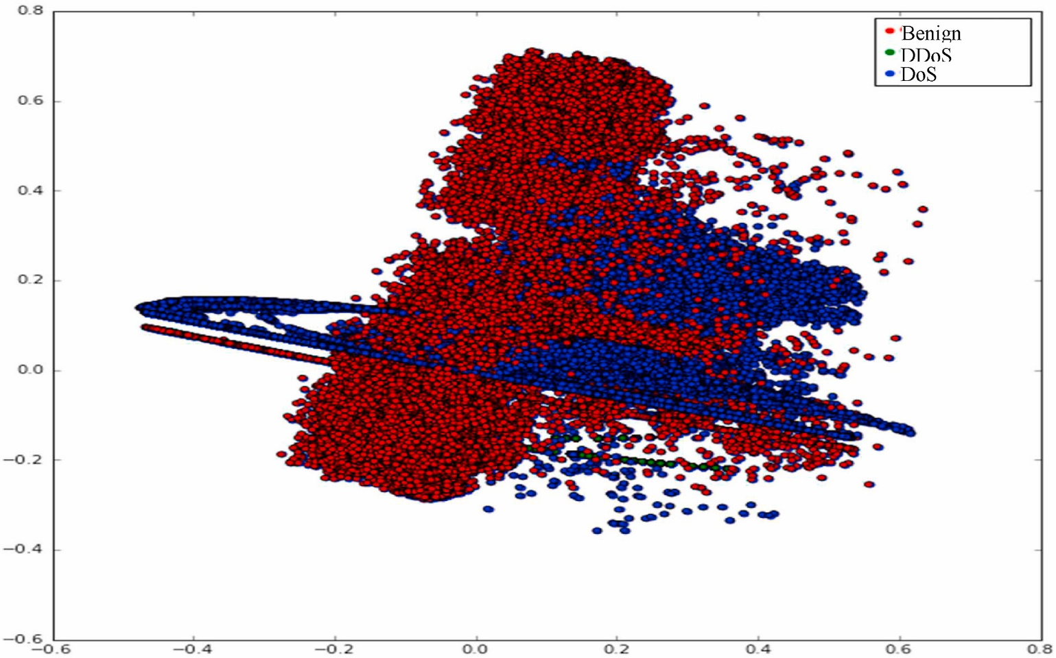
Cybersecurity Intrusion Detection
Type: Unsupervised
Description: Detecting abnormal patterns in network traffic
100

Slide 111
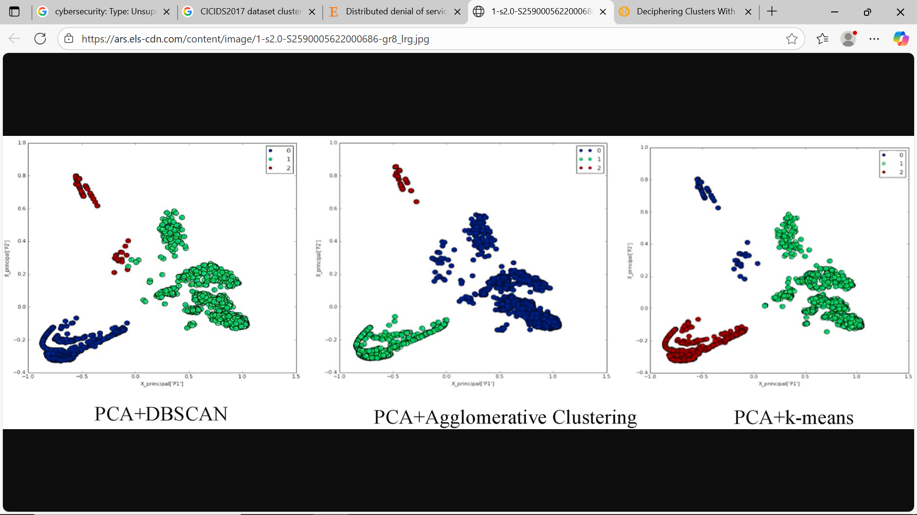
Cybersecurity Intrusion Detection
Type: Unsupervised
Description: Detecting abnormal patterns in network traffic
101

Slide 112
Predictive Maintenance
Type: Supervised
Description: Predicting failure in engines/drones
Predicting Engine/Drone Failures using Supervised Learning – Hands-on
https://colab.research.google.com/drive/1CYaUfPaJBxLljJofsGNPaErT1fqkaSMk?usp=sharing
102

Slide 113
Soldier Health Monitoring
Type: Supervised
Description: Predicting stress/fatigue from sensors
"Supervised Learning Example: Predicting Stress/Fatigue from Sensors",
This notebook demonstrates a supervised ML pipeline for predicting stress or fatigue levels from wearable sensor data.
Simulate physiological sensor readings like heart rate, skin temperature, activity level, and sleep hours.
https://colab.research.google.com/drive/1lLcCfZQ2AvGpYj4t6FXcIExFkRPSbV-v?usp=sharing
103

Slide 114
Clustering Intelligence Reports
Type: Unsupervised
Description: Grouping communications/reports
https://colab.research.google.com/drive/1A5WMX4Wk3xh3fG36DuJ768nGuFSr67qc?usp=sharing
Here’s how the 20 synthetic intelligence reports got grouped into KMeans clusters (0–3):
✨ The algorithm successfully separated the reports into logical themes:
Threats/terrorism (0)
Border & military activity (1)
Cybersecurity (2)
Smuggling/financial crimes (3)
TF_IDF
103

Slide 115
Thank You

